Slide 1
System Software .
Rejimoan R
Department of CSE
SCTCE
Notes:
‹#›

Slide 2
Outline of Chapter 1
System Software and Machine Architecture
The Simplified Instructional Computer (SIC)
Traditional (CISC) Machines
Complex Instruction Set Computers
RISC Machines
Reduced Instruction Set Computers
Chap 1
Notes:
‹#›

Slide 3
System Software vs. Machine Architecture
Machine dependent
The most important characteristic in which most system software differ from application software
e.g. assembler translate mnemonic instructions into machine code
e.g. compilers must generate machine language code
Machine independent
There are aspects of system software that do not directly depend upon the type of computing system
e.g. general design and logic of an assembler
e.g. code optimization techniques
Chap 1
Notes:
‹#›

Slide 4
The Simplified Instructional Computer (SIC)
SIC is a hypothetical computer that includes the hardware features most often found on real machines
Two versions of SIC
standard model
extension version
Chap 1
Notes:
‹#›

Slide 5
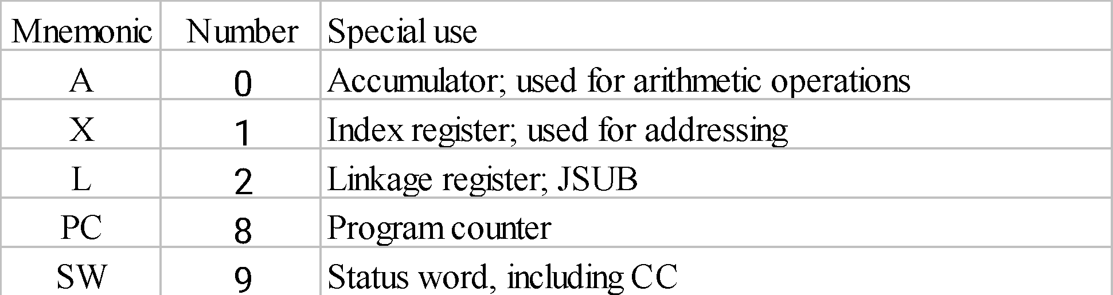
SIC Machine Architecture (1/5)
Memory
2¹⁵ bytes in the computer memory
3 consecutive bytes form a word
8-bit bytes
Registers
Chap 1
Notes:
‹#›

Slide 6
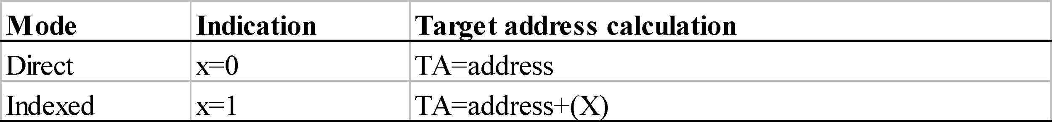
SIC Machine Architecture (2/5)
Data Formats
Integers are stored as 24-bit binary numbers; 2’s complement representation is used for negative values
No floating-point hardware
Instruction Formats
Addressing Modes
opcode (8)
x
address (15)
Chap 1
Notes:
‹#›

Slide 7
SIC Machine Architecture (3/5)
Instruction Set
load and store: LDA, LDX, STA, STX, etc.
integer arithmetic operations: ADD, SUB, MUL, DIV, etc.
All arithmetic operations involve register A and a word in memory, with the result being left in the register
comparison: COMP
COMP compares the value in register A with a word in memory, this instruction sets a condition code CC to indicate the result
Chap 1
Notes:
‹#›

Slide 8
SIC Machine Architecture (4/5)
Instruction Set
conditional jump instructions: JLT, JEQ, JGT
these instructions test the setting of CC and jump accordingly
subroutine linkage: JSUB, RSUB
JSUB jumps to the subroutine, placing the return address in register L
RSUB returns by jumping to the address contained in register L
Chap 1
Notes:
‹#›

Slide 9
SIC Machine Architecture (5/5)
Input and Output
Input and output are performed by transferring 1 byte at a time to or from the rightmost 8 bits of register A
The Test Device (TD) instruction tests whether the addressed device is ready to send or receive a byte of data
Read Data (RD)
Write Data (WD)
Chap 1
Notes:
‹#›

Slide 10
SIC Programming Examples
Data movement Fig. 1.2
Arithmetic operation Fig. 1.3
Looping and indexing Fig. 1.4, Fig. 1.5
Input and output Fig. 1.6
Subroutine call Fig. 1.7
Chap 1
Notes:
‹#›

Slide 11
SIC Programming Examples (Fig 1.2) -- Data movement
ALPHA RESW 1
FIVE WORD 5
CHARZ BYTE C’Z’
C1 RESB 1
.
.
LDA FIVE
STA ALPHA
LDCH CHARZ
STCH C1
(a)
No memory-memory move instruction
3-byte word:
LDA, STA, LDL, STL, LDX, STX
1-byte:
LDCH, STCH
Storage definition
WORD, RESW
BYTE, RESB
Notes:
‹#›

Slide 12
SIC Programming Examples (Cont.)
All arithmetic operations are performed using register A, with the result being left in register A.
BETA=ALPHA+INCR-ONE
DELTA=GAMMA+INCR-ONE
Chap 1
Notes:
‹#›

Slide 13
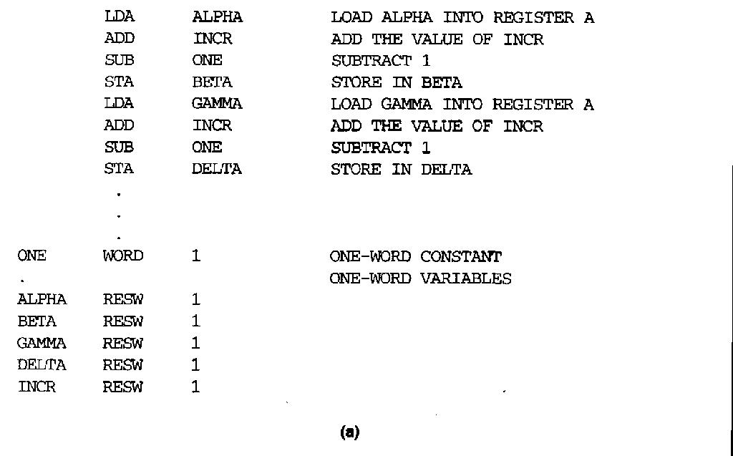
SIC Programming Example -- Arithmetic operation (Fig 1.3)
BETA=ALPHA+INCR-ONE
DELTA=GAMMA+INCR-ONE
Notes:
‹#›

Slide 14
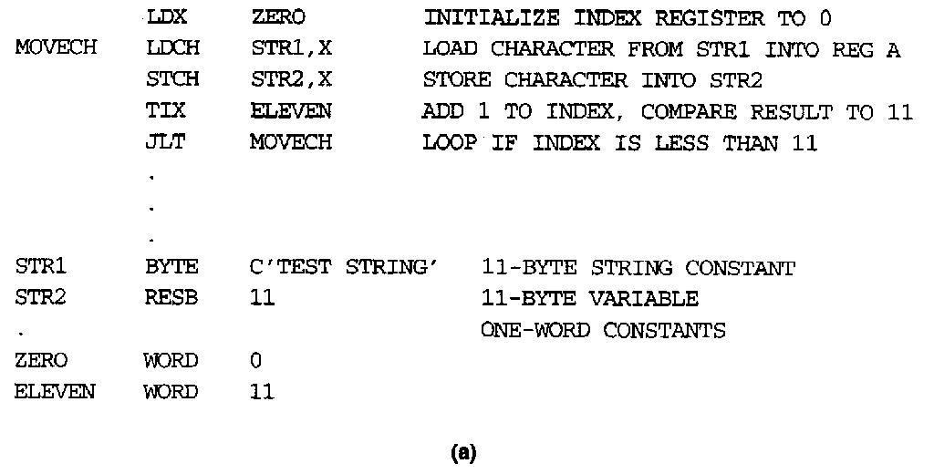
SIC Programming Example -- Looping and indexing (Fig. 1.4)
Chap 1
Notes:
‹#›

Slide 15
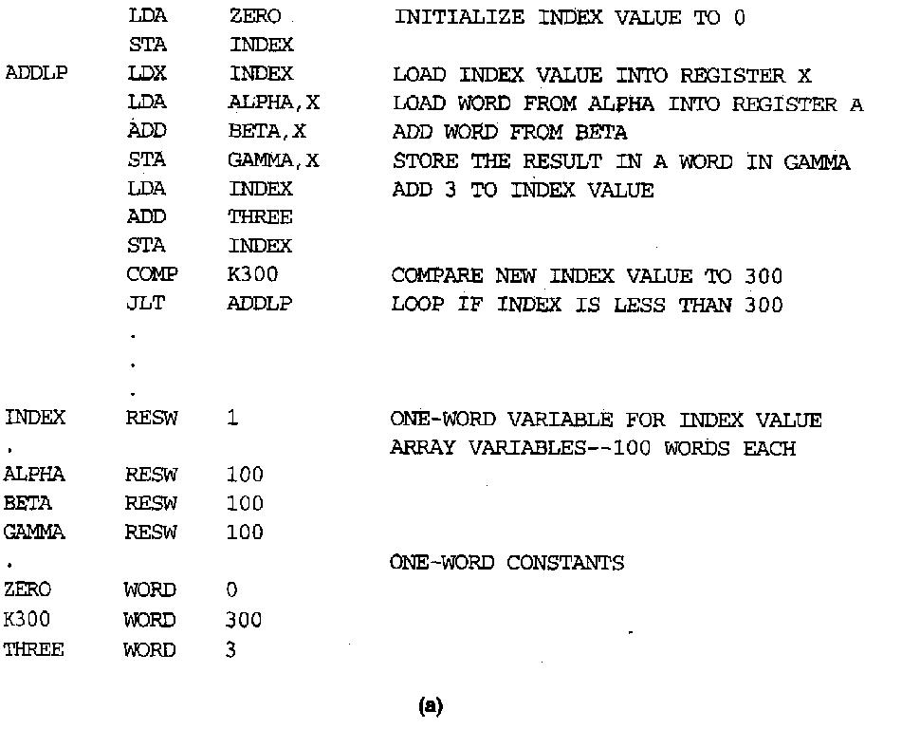
SIC Programming Example -- Looping and indexing (Fig. 1.5)
Arithmetic
Arithmetic operations are performed using register A, with the result being left in register A
Looping (TIX)
(X)=(X)+1
compare with operand
set CC
Break...
GAMMA[I]=ALPHA[I]+BETA[I]
I=0 to 100
Chap 1
Notes:
‹#›

Slide 16
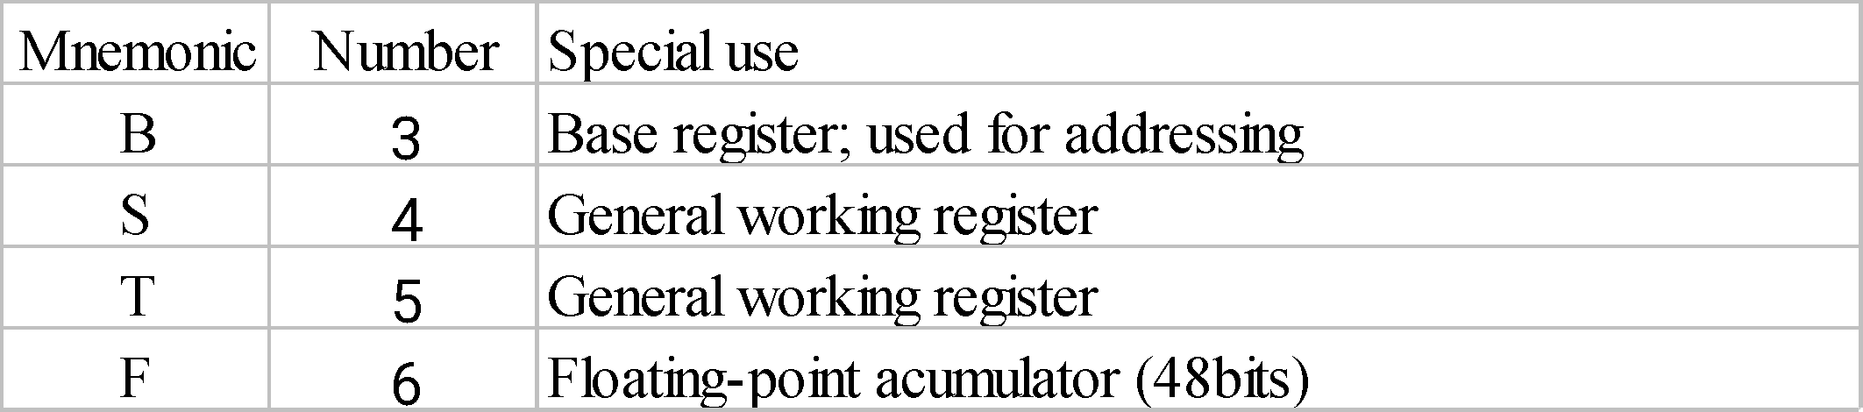
SIC/XE Machine Architecture (1/4)
Memory
2²⁰ bytes in the computer memory
More Registers
Chap 1
Notes:
‹#›

Slide 17
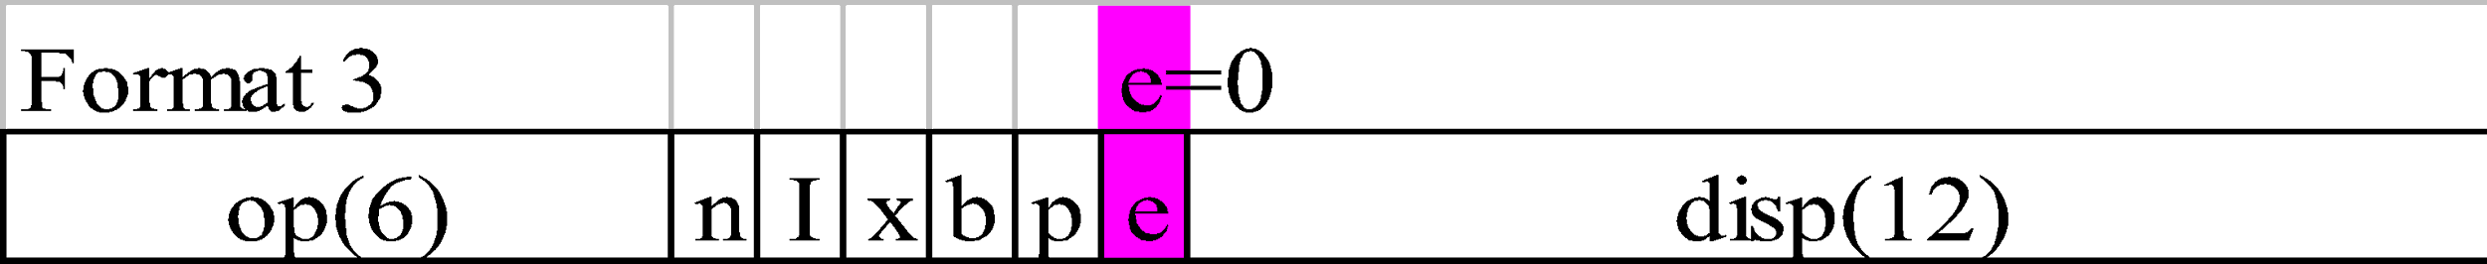
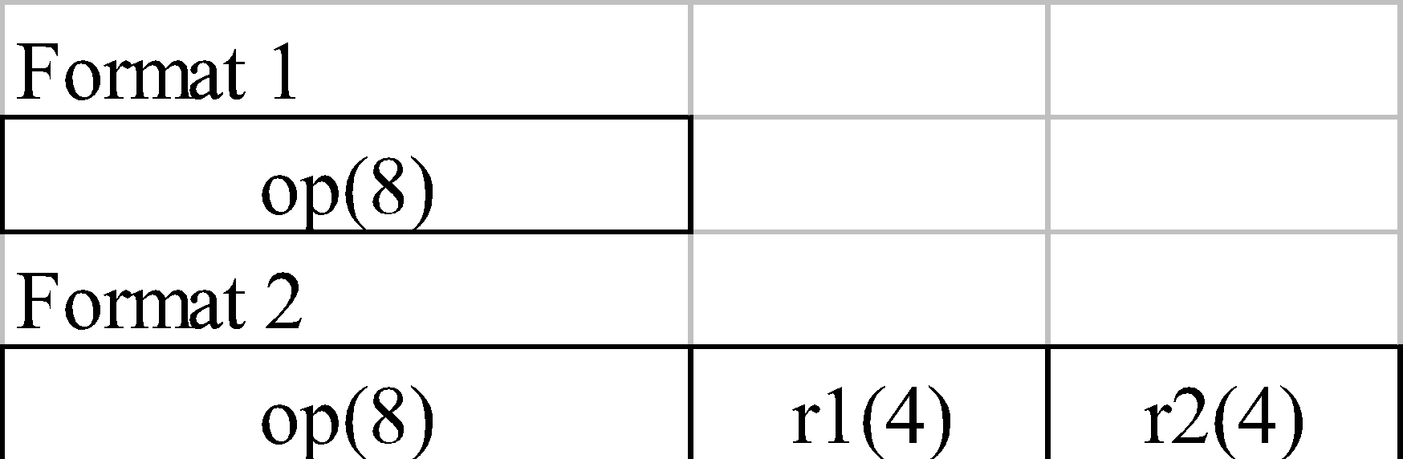
SIC/XE Machine Architecture (2/4)
Data Formats
Floating-point data type: frac*2^{(exp-1024)}
frac: 0~1
exp: 0~2047
Instruction Formats
s
exponent (11)
fraction (36)
Chap 1
Notes:
‹#›

Slide 18
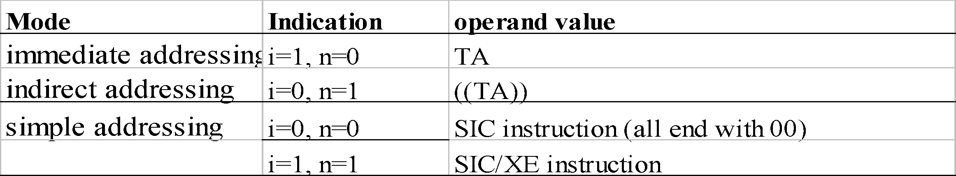
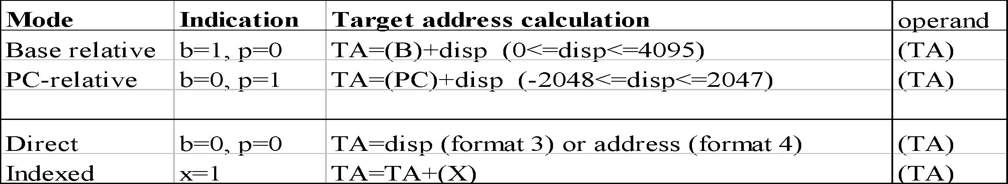
SIC/XE Machine Architecture (3/4)
How to compute TA?
How the target address is used?
Note: Indexing cannot be used with immediate or indirect addressing modes
Chap 1
Notes:
‹#›

Slide 19
Example of SIC/XE instructions and addressing modes
Notes:
‹#›

Slide 20
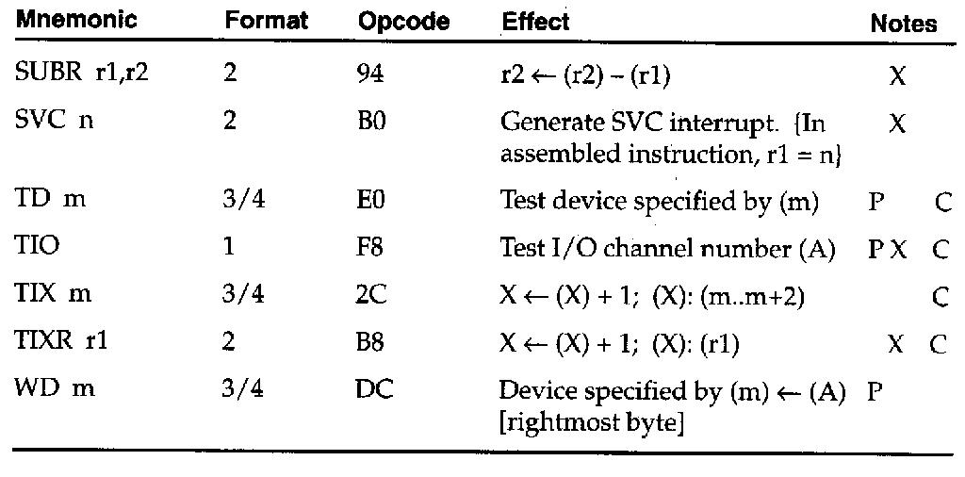
Chap 1
Notes:
‹#›

Slide 21
SIC/XE Machine Architecture (4/4)
Instruction Set
new registers: LDB, STB, etc.
floating-point arithmetic: ADDF, SUBF, MULF, DIVF
register move: RMO
register-register arithmetic: ADDR, SUBR, MULR, DIVR
supervisor call: SVC
generates an interrupt for OS (Chap 6)
Input/Output
SIO, TIO, HIO: start, test, halt the operation of I/O device (Chap 6)
Chap 1
Notes:
‹#›

Slide 22
SIC/XE Programming Examples (Fig 1.2)
ALPHA RESW 1
FIVE WORD 5
CHARZ BYTE C’Z’
C1 RESB 1
.
.
LDA FIVE
STA ALPHA
LDCH CHARZ
STCH C1
(a)
ALPHA RESW 1
C1 RESB 1
.
.
.
LDA #5
STA ALPHA
LDA #90
STCH C1
(b)
Notes:
‹#›

Slide 23
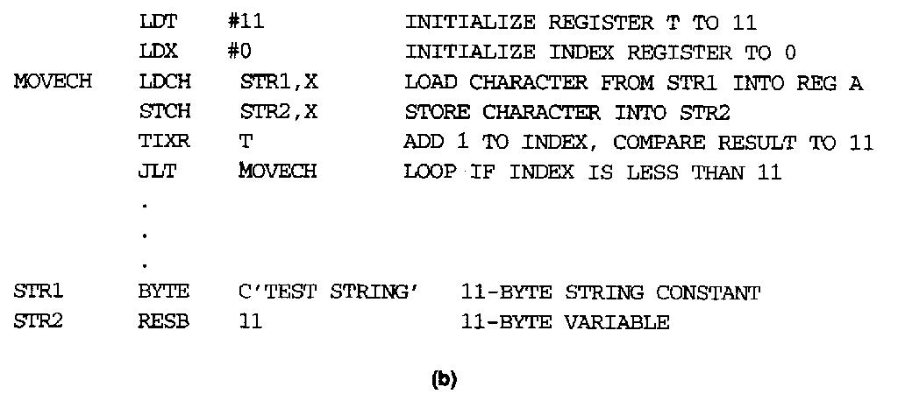
SIC/XE Programming Example -- Looping and Indexing Example (Fig 1.4)
Notes:
‹#›

Slide 24
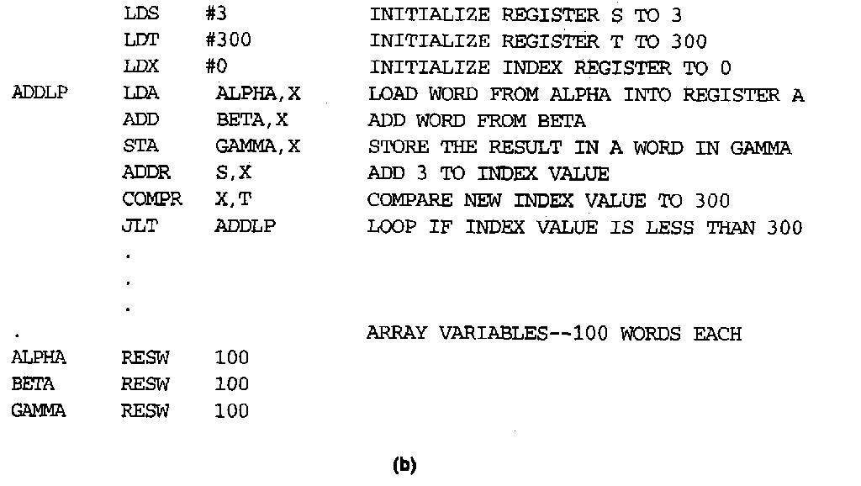
SIC/XE Programming Example -- Looping and indexing (Fig 1.5)
Notes:
‹#›

Slide 25
SIC/XE Programming Example
data movement
#: immediate addressing for SIC/XE
arithmetic
ADDR S,X
Looping (TIXR T)
(X)=(X)+1
compare with register specified
set CC
COMPR X,T
Chap 1
Notes:
‹#›

Slide 26
SIC Programming Example -- Sample Input and Output (Fig 1.6)
Notes:
‹#›

Slide 27
Homework #1
Write a sequence of instructions for SIC/XE to set ALPHA equal to 4*BETA-9. Assume that ALPHA and BETA are defined as in Fig. 1.3 (b)
Write a sequence of instructions for SIC to set ALPHA equal to the integer portion of BETA÷GAMMA. Assume that ALPHA and BETA are defined as in Fig. 1.3(a)
Chap 1
Notes:
‹#›

Slide 28
Homework #2
Please write a program for SIC/XE that contains routines. The routines read records from an input device (identified with device code F1) and copies them to an output device (code 05). This main routine calls subroutine RDREC to read a record into a buffer and subroutine ERREC to write the record from the buffer to the output device. Each subroutine must transfer the record one character at a time because the only I/O instructions available are RD and WD.
Chap 1
Notes:
‹#›

Slide 29
Homework #2
Program copy {
save return address;
cloop: call subroutine RDREC to read one record;
if length(record)=0 {
call subroutine WRREC to write EOF;
} else {
call subroutine WRREC to write one record;
goto cloop;
}
load return address
return to caller
}
Chap 1
Notes:
‹#›

Slide 30
Homework #2 (Cont.)
EOR:
character x‘00’
Subroutine RDREC {
clear A, X register to 0;
rloop: read character from input device to A register
if not EOR {
store character into buffer[X];
X++;
if X < maximum length
goto rloop;
}
store X to length(record);
return
}
Chap 1
Notes:
‹#›

Slide 31
Homework #2 (Cont.)
Subroutine WDREC {
clear X register to 0;
wloop: get character from buffer[X]
write character from X to output device
X++;
if X < length(record)
goto wloop;
return
}
Chap 1
Notes:
‹#›

Slide 32
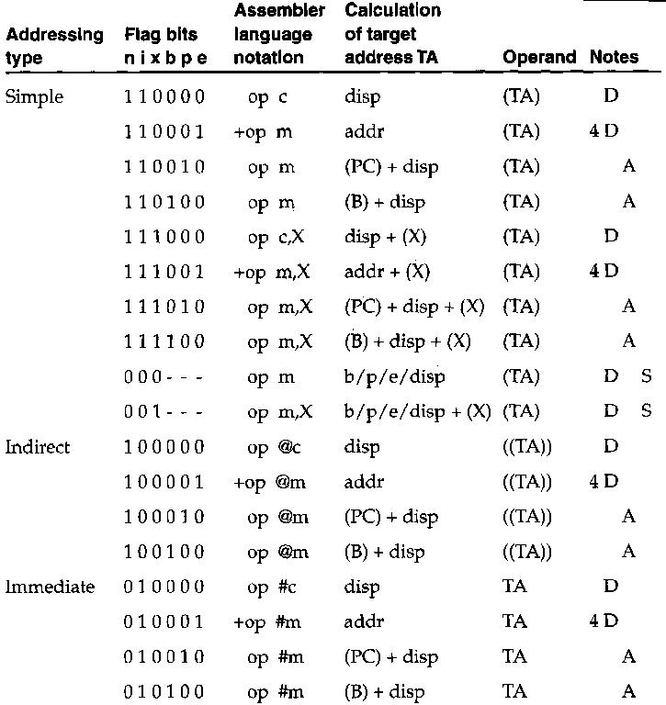
Chap 1
Notes:
‹#›

